Slide 1
Java Collections Framework
Include
interfaces
implementations
methods, that manipulates collections
Interfaces:
Collection // a group of elements
Set // no dublicates (~ mathematical set concept)
List // ordered Collection, each element has a position
Queue // ordered Collection with special operations (ex: FIFO)
SortedSet // ordered by the natural ordering of the elements // (Comparable)
Map // ~ table of (key,value)- pairs. No dublicate keys
SortedMap // ordered according to the natural order of the key //(Comparable)

Slide 2
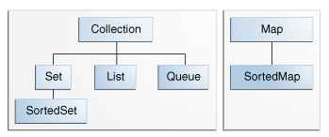
Interfaces in JCF

Slide 3
Implementations of interfaces
General-purpose Implementations
Interfaces | Hash table Implementations | Resizable array Implementations | Tree Implementations | Linked list Implementations | Hash table + Linked list Implementations
Set | HashSet |  | TreeSet |  | LinkedHashSet
List |  | ArrayList |  | LinkedList
Queue |  |  |  | (LinkedList)
Map | HashMap |  | TreeMap |  | LinkedHashMap
(SortedSet and Sorted Map)

Slide 4
Methods (algorithms)
The Collections class
sorting
shuffling
rutine data manipulation (List)
searching

